Slide 1

Ryan Bibby

Slide 2


Computer engineering
Computer engineers design computer hardware and software for things as simple as a mp3 player to the computer to control a MRI machine or an X- ray machine.

Slide 3

What training is required?
Most companies require at least a Bachelor’s degree. It will also help to get certification from the Institute of Electrical and Electronics Engineers also known as the IEEE.

Slide 4
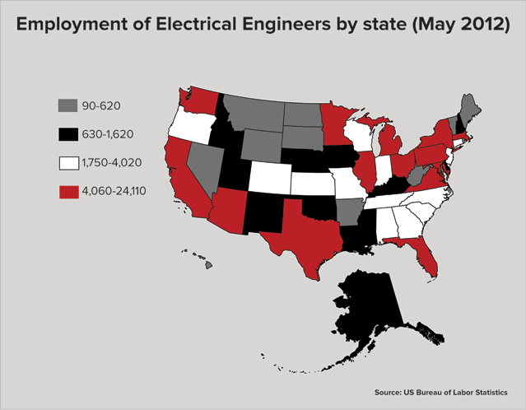

Where are the jobs for Computer Engineering?
Computer engineers work at hospitals, big companies such as Intel, AMD or NVIDIA designing the latest things to help people's life easier and better.
The average income starts at $76,000 and ends at $285,000
Just out of college pays $61,000 to $76,000

